Slide 1

Artificial Intelligence BAI402
Balaji Vijaykumar B.E.,(NIE), M.Tech.,(SJCE)
Assistant Professor, Department of CS&E-AIML
The National Institute of Engineering, Mysuru
(Former Research & Development Engineer @ Philips R&D)
(Former Software Engineer @ Accenture)

Slide 2

What is artificial intelligence (AI)?
Definition:
"Artificial intelligence (AI) is the branch of computer science focused on creating computer systems that can perform tasks that would normally require human intelligence. This includes tasks such as understanding natural language, recognizing patterns in data, making decisions, and learning from experience."
In addition to emulating human-like intelligence, AI computer systems should also exhibit rational behavior(Best possible outcome).
Rationality in AI refers to the ability of intelligent systems to make decisions or take actions that are optimal or appropriate given their objectives and the available information

Slide 3
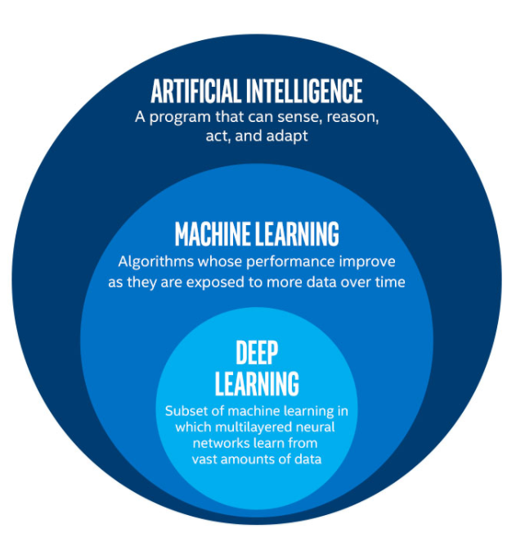
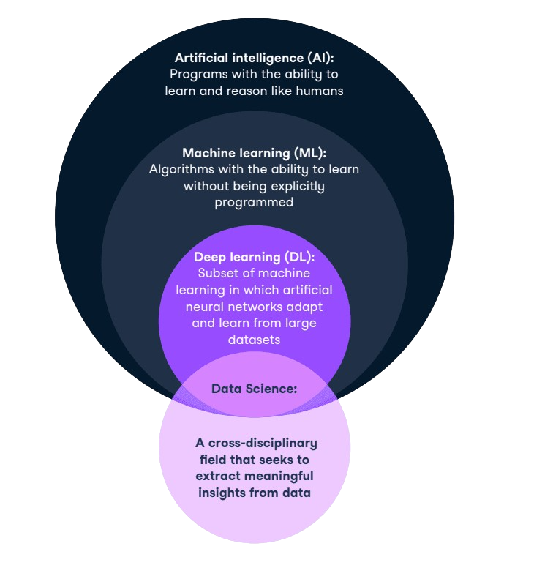
What is artificial intelligence (AI)?
John McCarthy is Professor of Computer Science at Stanford University. He has been interested in artificial intelligence since 1948 and coined the term in 1955.

Slide 4
Examples showcasing human capabilities alongside their AI counterparts
Understanding Natural Language:
Natural Intelligence: Humans effortlessly understand spoken and written language. For instance, when someone speaks to you in your native language, you understand the meaning of their words and can respond appropriately.
Artificial Intelligence: AI-powered virtual assistants like Siri, Alexa, and Google Assistant can understand spoken commands and respond with relevant information or perform tasks. Natural language processing (NLP) algorithms enable these systems to comprehend and generate human language.
2.Recognizing Patterns in Data:
Natural Intelligence: Humans have an innate ability to recognize patterns in visual, auditory, and other sensory data. For example, you can easily recognize a familiar face in a crowd or detect trends in a series of numbers.
Artificial Intelligence: Machine learning algorithms can be trained to recognize patterns in large datasets. For instance, AI systems can analyze medical images to identify signs of diseases like cancer, analyze financial data to detect fraudulent transactions, or recognize objects in images for applications like autonomous driving.

Slide 5
Examples showcasing human capabilities alongside their AI counterparts
3. Making Decisions:
Natural Intelligence: Humans make decisions based on a combination of knowledge, experience, and reasoning. For example, when faced with a choice, you consider various factors and outcomes to make the best decision.
Artificial Intelligence: AI systems can be designed to make decisions in various domains. For instance, recommendation systems use algorithms to suggest products or content based on user preferences, while autonomous vehicles make decisions about navigation and driving based on sensor data and predefined rules.
4. Learning from Experience:
Natural Intelligence: Humans learn from their experiences, both through direct interaction with the environment and through observation and instruction from others. For example, you learn to ride a bicycle by practicing and adjusting your behavior based on feedback.
Artificial Intelligence: Machine learning algorithms enable AI systems to learn from data and improve their performance over time. For example, spam filters learn to distinguish between spam and legitimate emails by analyzing user interactions with email messages. Similarly, chatbots can learn to generate more accurate responses through interactions with users.

Slide 6
Need for AI
Why do you think there's a continued focus on developing artificial intelligence, even though humans are already capable of performing tasks that AI aims to replicate?

Slide 7
Need for AI
While it's true that humans are capable of performing tasks that AI aims to replicate, there are several reasons why AI is valuable and why we continue to develop it a few among them are:
Scale and Efficiency: AI systems can perform tasks at a scale and speed that surpass human capabilities.
Consistency and Reliability: Unlike humans, AI systems can perform repetitive tasks consistently and without fatigue.
Handling Complexity: AI excels at processing and making sense of large amounts of complex data.
Automation: AI enables automation of tasks across various industries, freeing up human resources to focus on more creative or strategic endeavors.
Augmentation of Human Abilities: Rather than replacing humans, AI can augment human capabilities and enable us to achieve more.
Can you come up with creative examples in terms of applications of AI for above reasons?

Slide 8
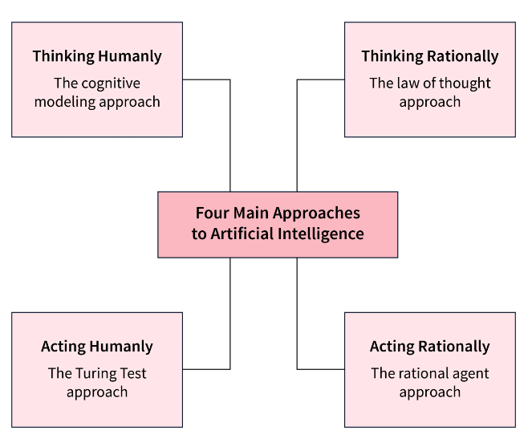
Approaches to Artificial Intelligence
The four approaches to AI represent different perspectives or methodologies for developing intelligent systems.
Humanly:
Emulating Human Intelligence: Humanly in AI refers to designing systems that imitate or replicate human-like intelligence, behavior, and capabilities.
Examples: Developing AI chatbots that can engage in conversations using natural language understanding, or creating robots that exhibit emotions and social behaviors similar to humans.
Rationally:
Optimizing Decision-Making: Rationally in AI means making decisions that are logical, optimal, or appropriate given the available information and objectives.
Examples: Designing self-driving cars that navigate roads safely and efficiently by analyzing sensor data and making decisions to minimize risks and reach their destinations in the most effective way.

Slide 9
Acting humanly: The Turing Test approach
Acting Humanly:
What it is: Making AI systems act or interact in ways that seem human-like.
Example: Developing virtual assistants like Siri or Alexa that can understand natural language commands and respond in a conversational manner.
The Turing Test, proposed by Alan Turing in 1950, is a benchmark for determining a machine's ability to exhibit human-like intelligence.
In this approach to AI, known as 'Acting Humanly,' the focus is on creating computer systems that can interact with humans in a way that is indistinguishable from human interaction.

Slide 10
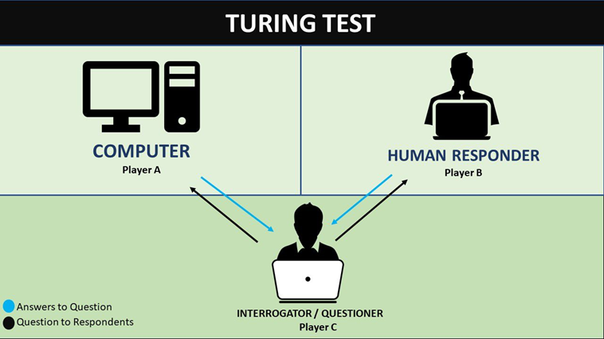
1.Acting humanly: The Turing Test approach
The test works by having a human interrogator engage in a conversation with both a human and a computer, without knowing which is which.
If the interrogator cannot reliably determine which responses come from the computer, then the computer is said to have passed the Turing Test.

Slide 11
1.Acting humanly: The Turing Test approach
To accomplish this, the computer must possess several key capabilities:
Natural Language Processing (NLP): The ability to understand and generate human language naturally is crucial for effective communication.
Knowledge Representation: The computer must be able to store and access knowledge, enabling it to answer questions and engage in meaningful dialogue.
Automated Reasoning: The capacity to use stored information to draw logical conclusions and respond appropriately to queries.
Machine Learning: Adaptability is essential for the computer to learn from interactions and improve its performance over time.
Computer Vision: To pass the 'Total Turing Test,' the computer must be able to perceive objects visually, allowing it to interact with the physical world.
Robotics: Additionally, the computer needs the capability to manipulate objects and move around physically, completing the requirements for the 'Total Turing Test.'

Slide 12
2. Thinking Humanly: The Cognitive Modeling Approach (Neurosymbolic AI). (Neuromorphic computing)
Understanding human thought processes is essential for creating AI systems that can think and behave like humans.
Methods of Understanding Human Cognition:
Introspection: Attempting to grasp our own thoughts and mental processes as they occur.
Psychological Experiments: Observing individuals in various tasks and situations to study how they think and make decisions.
Brain Imaging: Utilizing technologies such as brain imaging to observe brain activity during cognitive tasks, providing insights into neural mechanisms underlying cognition.
Expressing Human Cognition as Computer Programs:
Once researchers have developed a sufficiently precise theory of human cognition, they can translate it into computer programs.
These programs attempt to replicate the cognitive processes observed in humans, such as problem-solving, decision-making, and language understanding.
Validating Cognitive Models:
Researchers compare the behavior of these AI systems with human behavior to validate the cognitive models.
For example, pioneers like Allen Newell and Herbert Simon developed the "General Problem Solver" (GPS) and compared its problem-solving steps with those of human subjects, providing evidence for shared cognitive mechanisms.

Slide 13
2. Thinking Humanly: The Cognitive Modeling Approach
1. Cognitive Computing
Cognitive computing aims to replicate the human brain’s ability to learn, reason, and make decisions. It's about developing systems that think, reason, and learn in a way that's similar to how humans do.
2. Neuromorphic Computing
This area involves building AI models based on how the human brain works. Neuromorphic systems attempt to replicate the structure and functioning of neurons and synapses to enable more human-like learning and decision-making.

Slide 14
3. Thinking rationally: The “laws of thought” approach
The "Laws of Thought" approach, rooted in the work of Greek philosopher Aristotle, seeks to formalize irrefutable reasoning processes through logic. Aristotle's syllogisms, such as "Socrates is a man; all men are mortal; therefore, Socrates is mortal," provided foundational patterns for constructing valid arguments.
The "Laws of Thought" approach is all about using formal rules of reasoning to solve problems. It's like following a set of rules to reach the right answer every time, just like in a game with strict rules.
Key Points:
Foundation in Logic: This approach is based on using rules of logic, like those created by the ancient Greek philosopher Aristotle.
Logic in Artificial Intelligence: People have made computer programs that can follow these logical rules to solve problems.
Challenges: Sometimes, it's hard to turn real-life situations into these logical rules. Also, these programs can get stuck if they have too much to think about, like trying to solve a problem with too many pieces.

Slide 15
3. Thinking rationally: The “laws of thought” approach
Example 1:
Let's say we want to figure out if someone named Sarah is a teacher. Using the "Laws of Thought" approach, we might use a logical rule like this:
If Sarah is a teacher, then she works at a school.
Sarah works at a school.
Therefore, Sarah is a teacher.
Example 2:
Now, let's consider another scenario. We want to determine if someone named John is a professor. We might use a logical rule like this:
If John is a professor, then he works at a college.
John works at a college.
Therefore, John is a professor.
This process again uses logical steps to reach a conclusion. It's like following a recipe where each step leads to the next until we have our answer.

Slide 16
3. Thinking rationally: The “laws of thought” approach
It involves creating knowledge-based systems that use:
Propositional Logic: Statements are either true or false.
First-Order Logic: Involves objects, relations, and quantifiers to form more complex and rational conclusions.
Inference Mechanisms: Such as forward chaining, backward chaining, and resolution, which help derive new facts from known facts logically.
Real-World Example:
A medical diagnosis system using the "Laws of Thought" approach might use logical rules like:
Rule: If a patient has a fever and a sore throat, then they might have a throat infection.
Input: The system receives information that a patient has a fever and a sore throat.
Inference: Using logical rules, the system concludes a possible throat infection and suggests appropriate tests or treatment.

Slide 17
4. Acting rationally: The rational agent approach
In the world of artificial intelligence, An agent is something that acts autonomously to achieve its goals.
A rational agent, in particular, is one that makes decisions to achieve the best outcome or, when faced with uncertainty, the best expected outcome.
Acting Rationally refers to making the best possible decisions to achieve specific goals.
Rational Agent Approach: An AI approach where agents act to maximize their performance measure.
Example 1:
Let's think about a robot in a factory. Its job is to assemble cars. To do this, it has to do many things:
Perceive its Environment: It needs to see where the car parts are and understand how to pick them up.
Operate Autonomously: It works on its own without needing someone to tell it what to do all the time.
Persist Over Time: It works for a long time without getting tired or needing breaks.
Adapt to Change: If there's a problem, like a part missing, it finds a solution to keep working.
Create and Pursue Goals: Its main goal is to assemble cars correctly and efficiently.

Slide 18
4. Acting rationally: The rational agent approach
Example 2: Autonomous Cars
Imagine a self-driving car. It's programmed to drive safely, avoid accidents, and get you to your destination quickly. To do this, it has to perceive its environment, like detecting other cars and pedestrians, adapt to changes, such as road closures or traffic jams, and make decisions, like when to change lanes or slow down. The car's goal is to get you to your destination safely and efficiently, so it acts rationally by following traffic rules and choosing the best route.
Advantages: The rational agent approach is flexible and allows for designing intelligent systems that can handle various tasks and situations effectively.
Main Challenge: Achieving Perfect Rationality
Perfect rationality means always making the best decisions, no matter what. However, in real-life situations, this can be very difficult because the computational resources needed to make perfect decisions can be too high, especially when faced with complex problems.

Slide 19
Foundations of Artificial Intelligence
1.Mathematics:
Historical Context: Mathematics has been integral to the development of AI since its inception. Early pioneers such as Alan Turing and John von Neumann laid the groundwork for computational theory and introduced concepts like algorithms and computation.
Contributions to AI: Mathematical disciplines such as logic, probability theory, and optimization provided the formal frameworks for reasoning, decision-making, and learning in AI systems. Symbolic logic, introduced by George Boole, became foundational for representing knowledge and reasoning in AI.
Example: In machine learning, algorithms use mathematical models to analyze data and make predictions. Linear algebra, calculus, and probability theory are essential mathematical concepts used in AI.
Application: Imagine you're teaching a computer to recognize cats in pictures. Mathematics helps the computer understand patterns in cat images, like the shape of ears or whiskers, so it can say, "Yes, that's a cat!" when it sees one.

Slide 20
Foundations of Artificial Intelligence
2.Neuroscience:
Historical Context: The study of the brain's structure and function has inspired AI researchers to model artificial neural networks after biological neurons. The concept of neural networks dates back to the 1940s with the work of Warren McCulloch and Walter Pitts, who proposed a computational model of the brain.
Contributions to AI: Neural network models, inspired by the brain's neural connections, became a cornerstone of AI research, leading to breakthroughs in pattern recognition, speech processing, and machine learning.
Example: Artificial neural networks, inspired by the structure and function of the human brain, are used in deep learning to recognize patterns in data, such as images or speech.
Application: Have you ever played a game where a computer learns to beat you? That's like a brainy AI copying how your brain learns from experience to get better at the game.

Slide 21
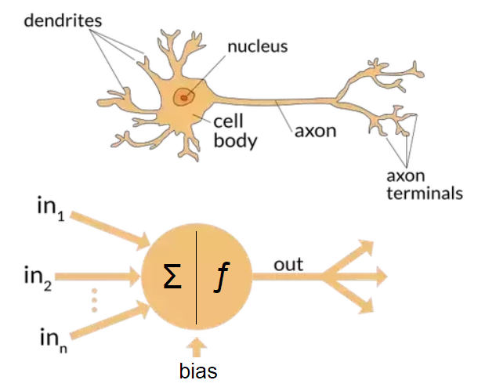
Foundations of Artificial Intelligence
2.Neuroscience:

Slide 22
Foundations of Artificial Intelligence
3. Computer Engineering:
Historical Context: Computer engineering provided the hardware and software infrastructure necessary for AI systems to operate. Early computing machines, such as the ENIAC(Electronic Numerical Integrator And Computer) and UNIVAC(Universal Automatic Computer), laid the foundation for digital computing and programmable logic.
Contributions to AI: Advances in computer hardware, including the development of microprocessors, memory storage, and parallel computing, enabled the processing power required for AI algorithms. Programming languages like Lisp and Prolog were developed specifically for AI applications.
Example: High-performance computing systems, such as Graphics Processing Units (GPUs) or specialized hardware accelerators, are designed to handle complex computations required by AI algorithms.
Application: Think of your computer or smartphone. Engineers make them faster and better so they can run AI programs smoothly, like voice assistants or video games that can learn and adapt.

Slide 23
Foundations of Artificial Intelligence
4.Linguistics:
Historical Context: Linguistics studies the structure and evolution of human language, which influenced early AI researchers' efforts to understand and process natural language. Noam Chomsky's work on generative grammar and language universals provided theoretical insights into language structure.
Contributions to AI: Natural language processing (NLP) techniques, drawing from linguistic principles, enabled AI systems to understand, generate, and translate human languages. Rule-based systems and statistical models were developed to analyze syntax, semantics, and pragmatics in text and speech.
Example: Chatbots and virtual assistants use NLP techniques to understand and generate human-like responses to text or speech inputs, enabling interactions with users in natural language.
Application: When you talk to Siri or Alexa, they understand what you're saying and give you answers. That's because AI uses linguistics to understand and respond to your commands.

Slide 24
Foundations of Artificial Intelligence
5.Control Theory and Cybernetics:
Control theory helps us build robots and machines that can make decisions on their own, like self-driving cars or robots that clean your house.
Historical Context: Control theory and cybernetics emerged in the mid-20th century to study systems' behavior and regulation. Early cyberneticists like Norbert Wiener and Claude Shannon investigated feedback mechanisms and self-regulating systems.
Contributions to AI: Concepts from control theory, such as feedback loops and adaptive control, inspired the development of autonomous agents and robots capable of self-regulation and decision-making. Cybernetics provided theoretical frameworks for understanding systems' dynamics and interactions in AI applications.
Example: autonomous vehicles use control theory principles to navigate and make decisions in real-time, adjusting their actions based on sensor inputs and environmental feedback.
Application: Imagine a robot vacuum cleaner that moves around your house without bumping into things. It uses control theory to sense obstacles and navigate around them, just like you would avoid obstacles while walking.

Slide 25
THE STATE OF THE ART
The field of artificial intelligence (AI) has seen remarkable advancements in recent years, enabling a wide range of applications that were once considered futuristic. Here are some examples of what AI can do today:
Autonomous Vehicles:
Instead of relying on human drivers, autonomous vehicles equipped with sensors, cameras, and onboard software can navigate through various environments. For example, self-driving cars like Tesla's Autopilot and Waymo's driverless taxis can safely navigate city streets and highways, obey traffic rules, and avoid obstacles.
Speech Recognition:
Automated speech recognition systems can understand and respond to human speech commands. Virtual assistants like Siri, Alexa, Bixby and Google Assistant allow users to perform tasks hands-free, such as making phone calls, setting reminders, or playing music, simply by speaking to their devices.
Autonomous Planning and Scheduling:
AI-powered systems can autonomously plan and schedule complex operations. For instance, NASA's Remote Agent program and its successors, such as MAPGEN and MEXAR2, autonomously plan and execute daily operations for spacecraft and planetary rovers to explore planets or other celestial bodies, ensuring efficient mission management and problem-solving capabilities.
MAPGEN is responsible for creating detailed schedules and plans for what the spacecraft or rover should do each day, while MEXAR2 is in charge of making sure those plans are carried out smoothly and adjusting them if needed based on the actual conditions encountered during the mission.

Slide 26
THE STATE OF THE ART
Game Playing:
AI algorithms have surpassed human players in various games, demonstrating advanced strategic thinking and decision-making abilities. Examples include DeepMind's AlphaGo, which defeated world champion Go players, and IBM's Deep Blue, which defeated chess grandmaster Garry Kasparov.
Spam Filtering:
Learning algorithms can automatically classify and filter spam emails, saving users from the inconvenience of sorting through unwanted messages. These algorithms continually adapt to new spamming tactics, ensuring effective email management and reducing the risk of phishing attacks.
Example: When you receive an email in your Gmail inbox, Google's spam filtering algorithms automatically analyze the content and characteristics of the email to determine whether it is likely to be spam or not. If the email is flagged as potential spam, Gmail will typically move it to the spam folder, keeping your inbox clean from unwanted messages.
Logistics Planning:
AI-driven tools facilitate automated logistics planning and scheduling for complex operations, such as military deployments and transportation logistics. These systems optimize routes, allocate resources, and resolve conflicts efficiently, significantly reducing planning time and enhancing operational effectiveness.

Slide 27
THE STATE OF THE ART
Robotics:
Robotic technologies, like iRobot's Roomba vacuum cleaners and PackBot deployed in military operations, demonstrate the versatility of AI-driven robots. These robots can perform tasks ranging from household cleaning to hazardous materials handling and reconnaissance in combat zones.
Machine Translation:
AI-powered machine translation systems enable real-time translation between languages, breaking down language barriers and facilitating global communication. These systems leverage statistical models and machine learning algorithms to produce accurate translations, even for languages with complex syntax and semantics.

